Slide 1

Event Management System
CSE 111 Database Systems Fall 2022
Johnny Ly
Samish Kavoori

Slide 2

System Description
Our project is a simple calendar
Web application written in React and Node JS
Users can:
Create an account
Make edits such as time, location, and other event details
View all events in calendar / list format
Create events
Admins can:
Manage user accounts

Slide 3







Implementation Details
LANGUAGES
INTEGRATED DEVELOPMENT ENVIRONMENT (IDE)
DATABASE
HTML, CSS, JavaScript
React
Node JS
SQLite3
Visual Studio Code

Slide 4
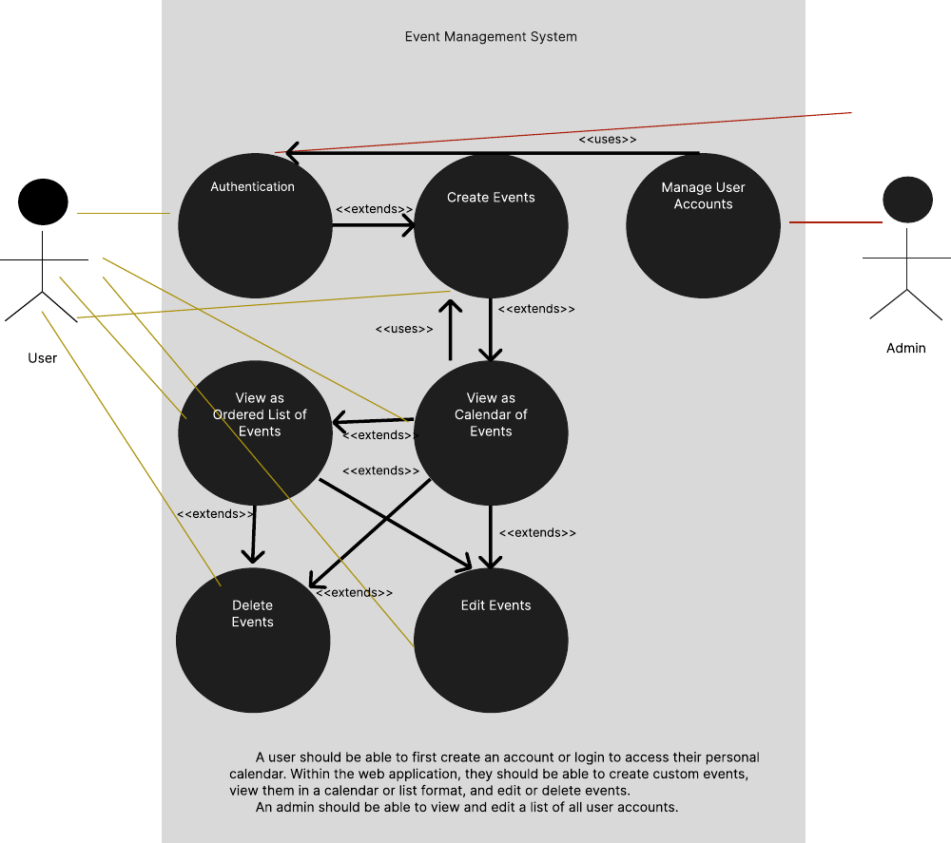
Use-Case Diagram

Slide 5
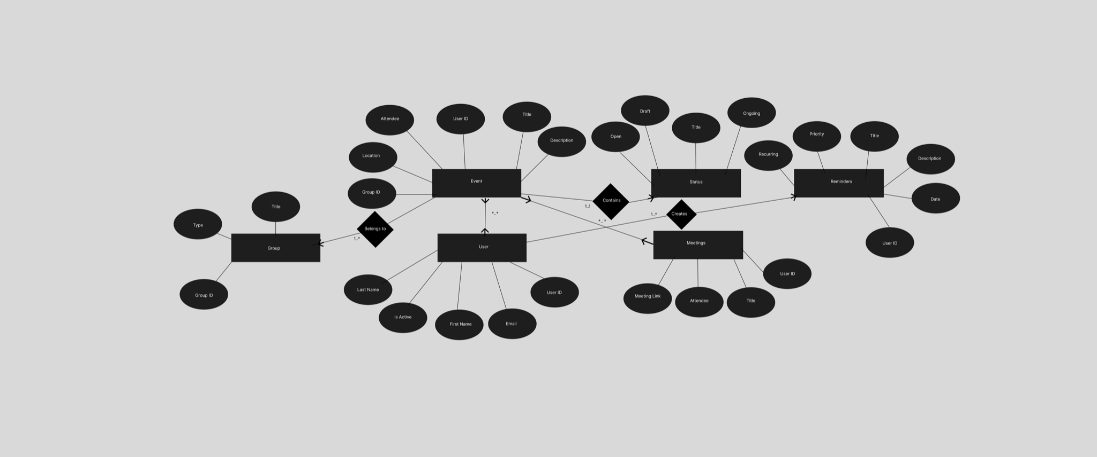
E/R Diagram
Notes:
Need 6 entities, so far we only have 4 according to him
He was confused about Delete Event, Edit Event and said something about them mostly being functions rather than tables that store data
For now, we should fix it because in phase 2 and 3 he’s going to ask us about it again and we’ll lose points on it
Also need minimum many to many relationship so maybe meetings could be one of them

Slide 6
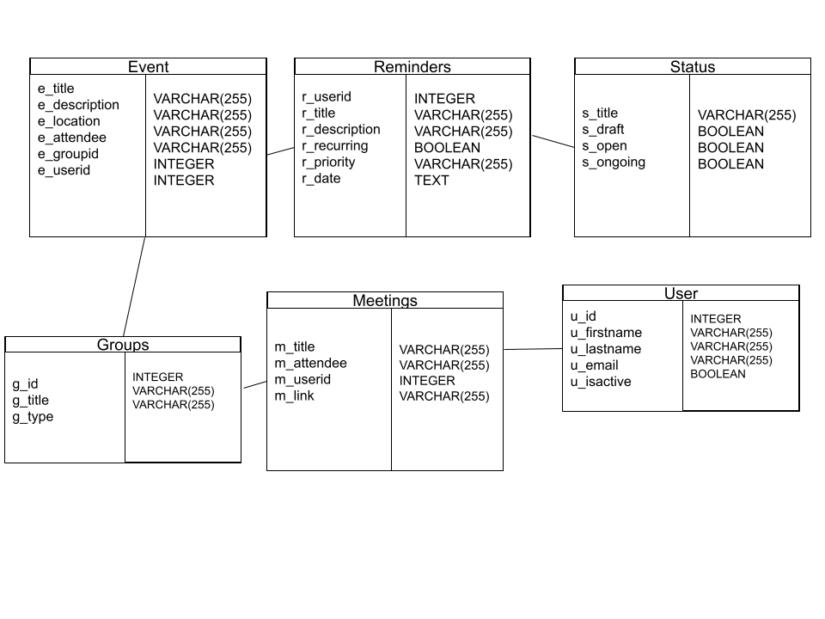
Relational Schema

Slide 7
THANK YOU
Do you have any questions?

